Slide 1
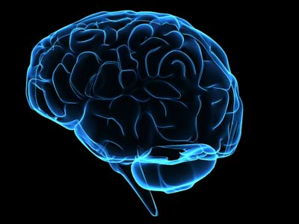
Nervous System
By Shivam Singh

Slide 2
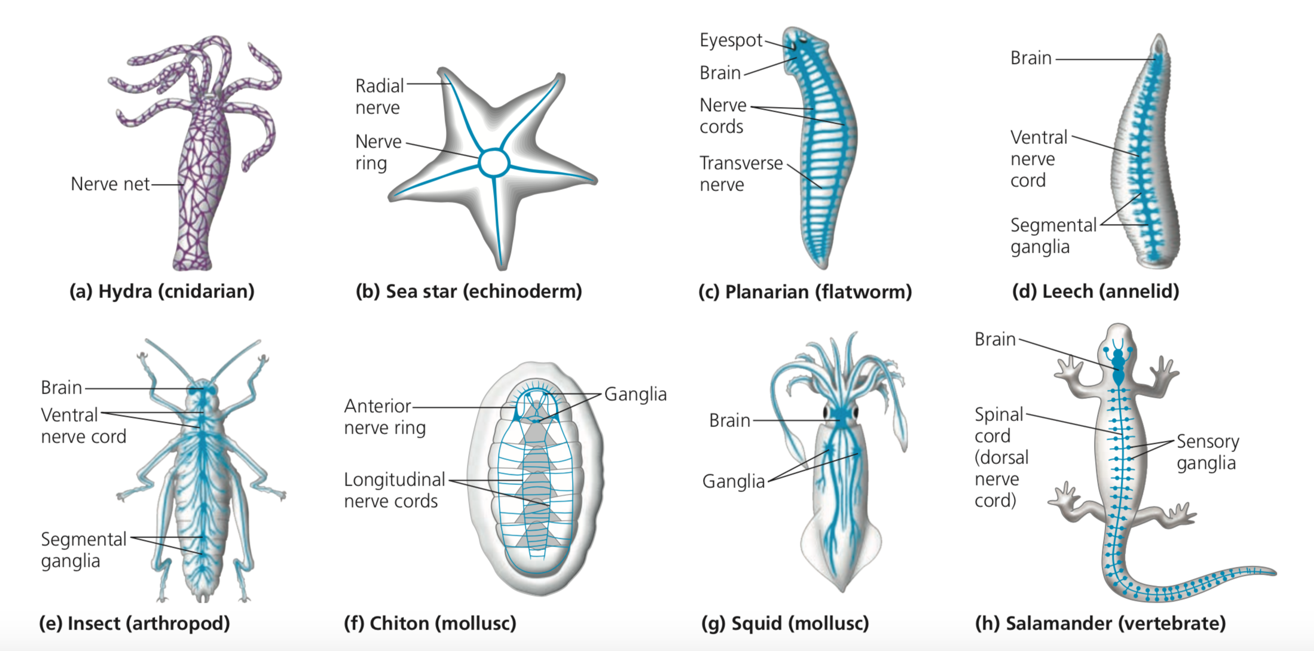
Types of Nervous Systems
Nerve net
Ganglia
Segmentally arranged clusters of neurons
Cephalization
Sensory neurons and interneuron cluster at front

Slide 3
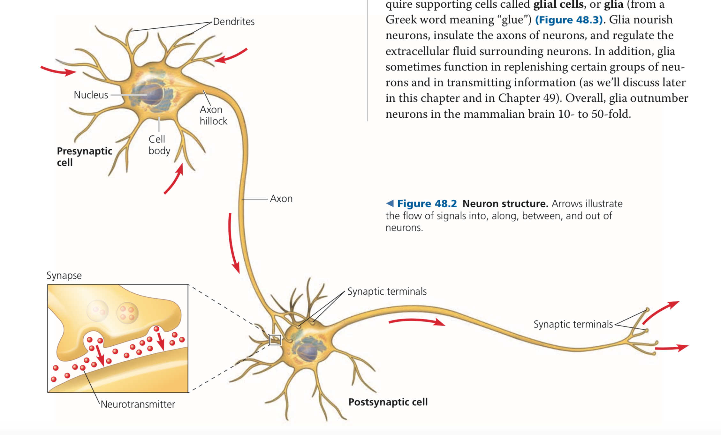
Basic Anatomy of Neuron
Soma
Cell body
Nucleus
Dendrites
Excitatory or inhibitory response
Neurotransmitters
Axon
Axon hillock
Glial Cells
NOT neurons
Important supporting roles

Slide 4
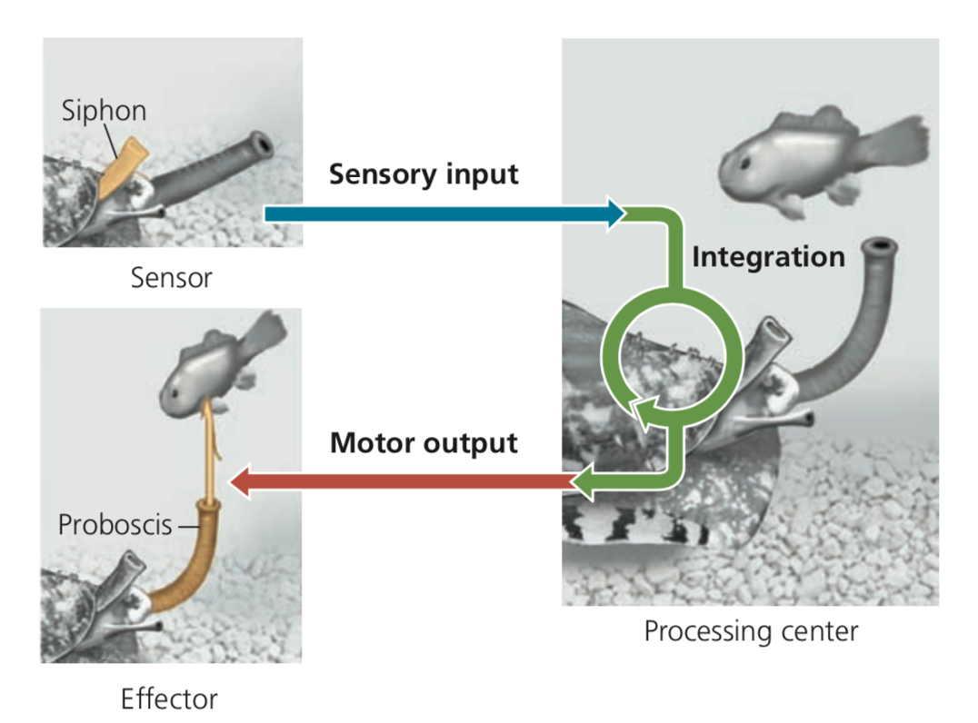
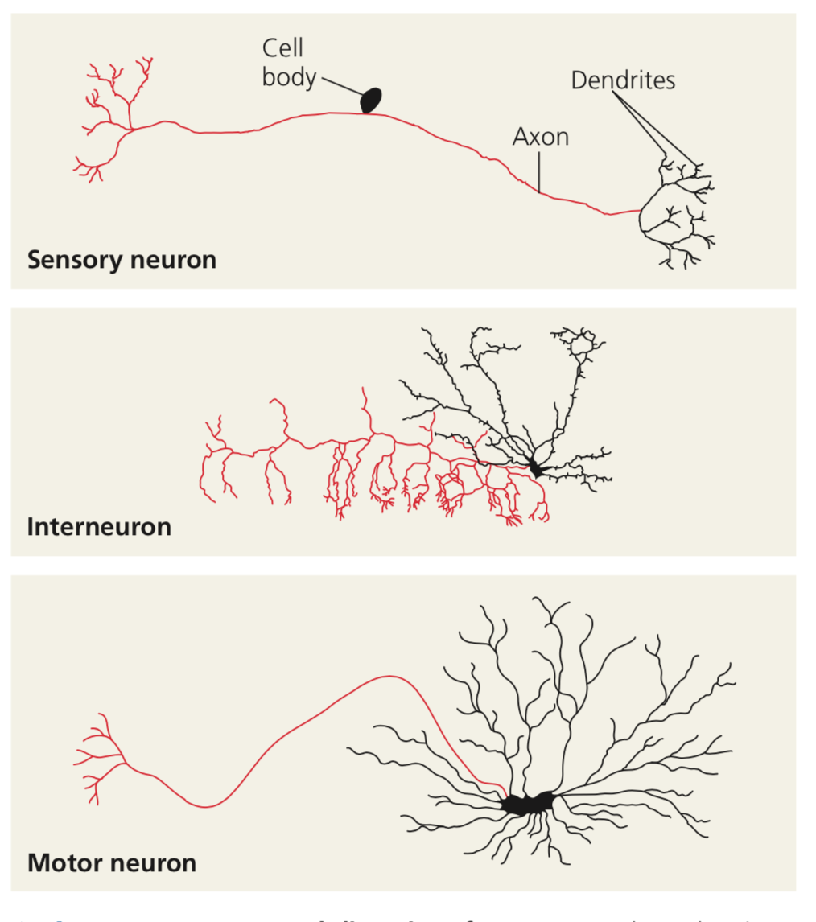
How information is processed

Slide 5
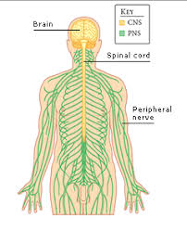
CNS / PNS
Nervous System is composed of:
Central Nervous System
Carry out integration
Peripheral Nervous System
Carry information out of and into the CNS
Lots of neurons together form nerves

Slide 6
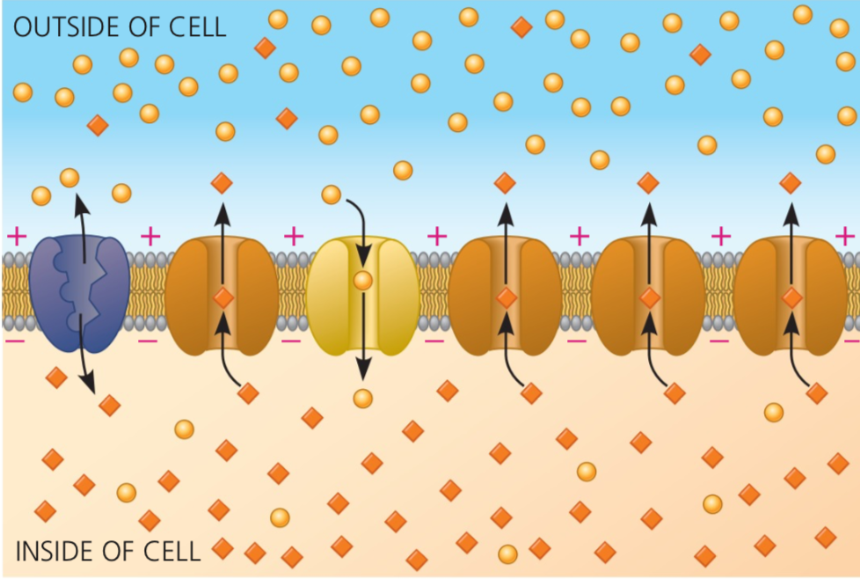
Membrane Potential
The sodium and potassium pump maintain membrane equilibrium:
3 Na⁺ out and 2 K⁺ in
Creates negative charge inside
Most membrane potential
POTASSIUM CHANNELS

Slide 7
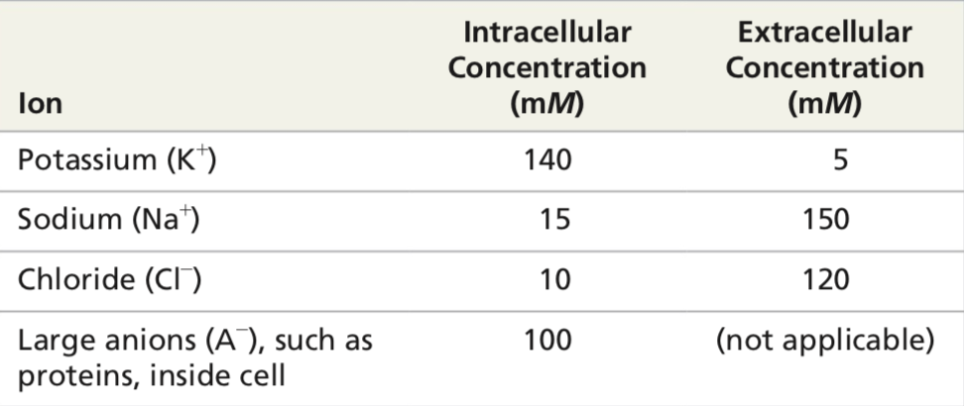
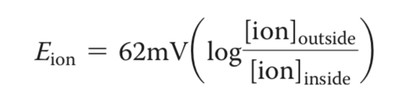
Important Ion Concentrations
Using the formula for E_{ion} :
Charge from K⁺
-90 mV
Charge from Na⁺
+62 mV
Most K⁺ but some Na⁺
≈ -70 mV

Slide 8
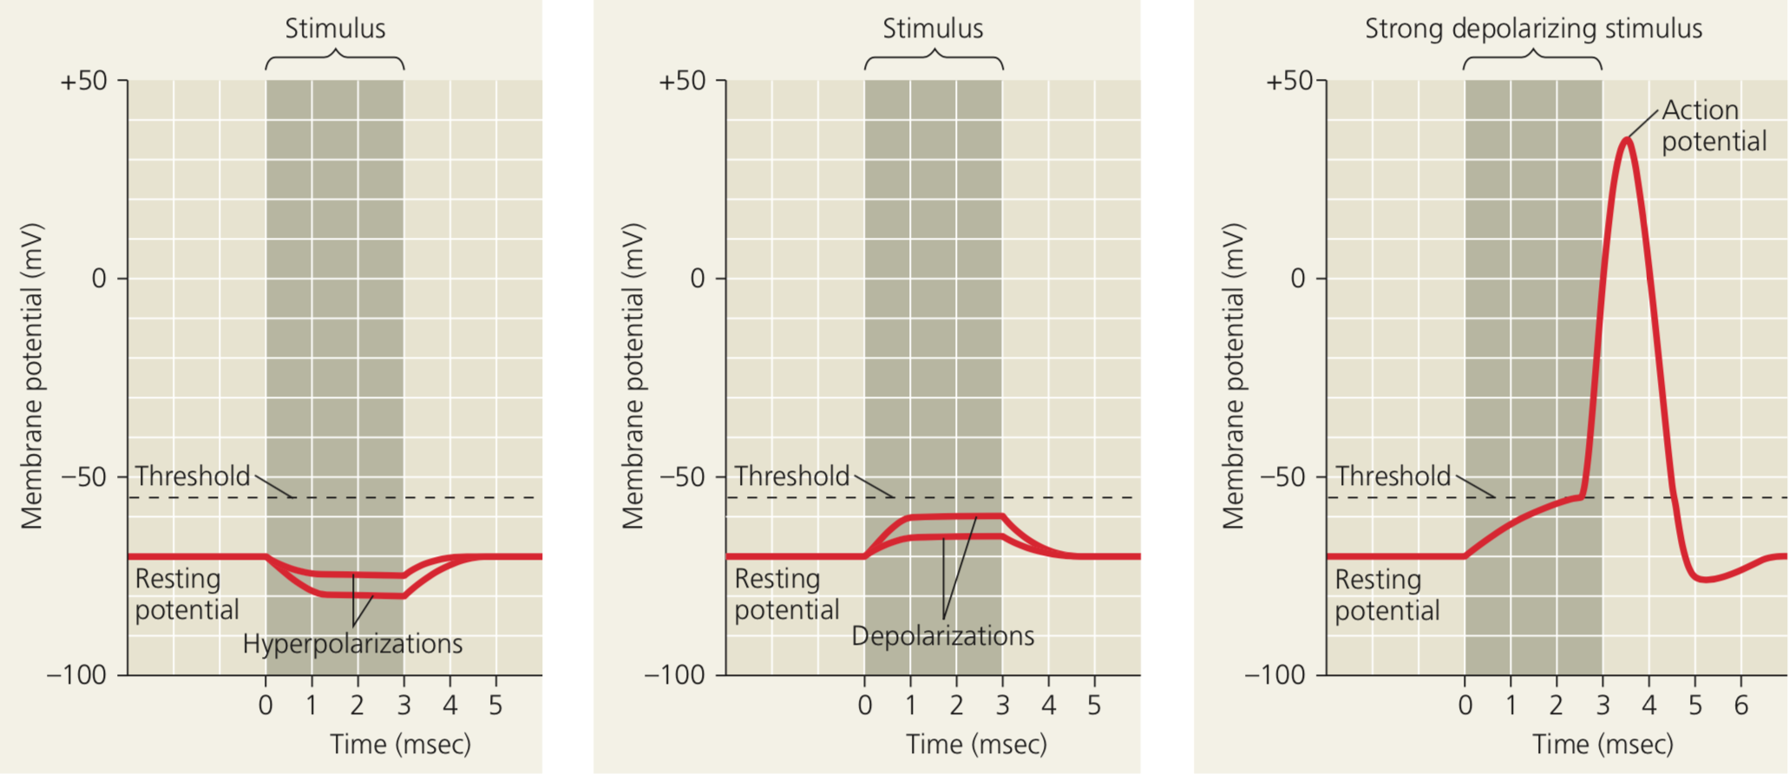
Role of ion channels in Neurons

Slide 9
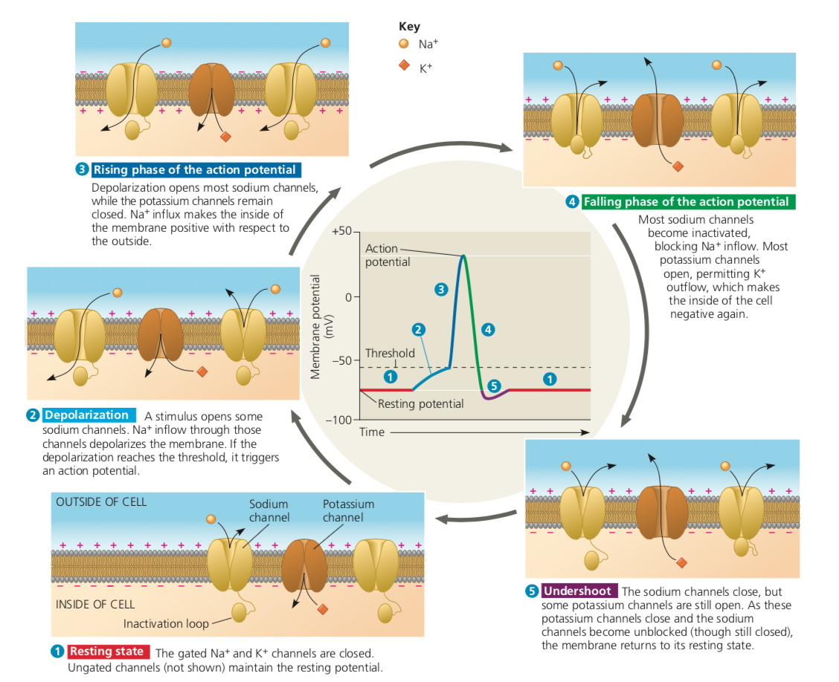

Slide 10
Refractory Period
During falling phase of action potential
New graded potentials cannot be initiated
Due to blocked Na⁺ channels
NOT due to ion gradient
No action potentials allowed

Slide 11
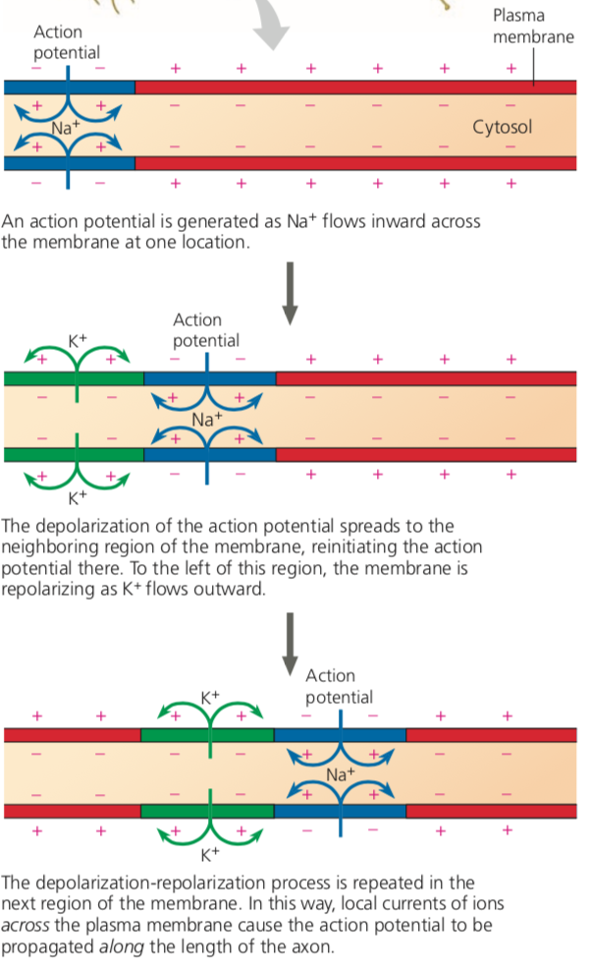
Conduction of Action Potential: 1

Slide 12
Conduction of Action Potential: 2

Slide 13
Conduction of Action Potential: 3

Slide 14
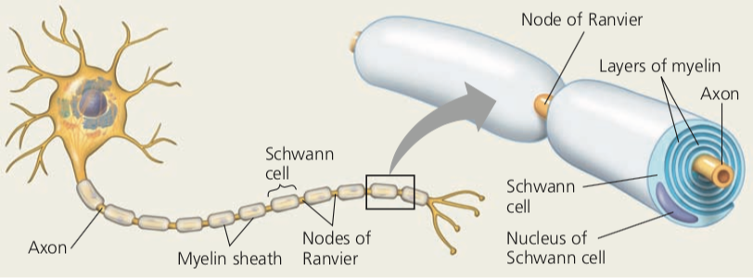
Evolution: Faster Transmission of Signals
Faster signal = quicker response
Escape predator or get prey
Wide axons
Squid
1mm long axon
Insulated axons
Humans
Myelin sheath

Slide 15
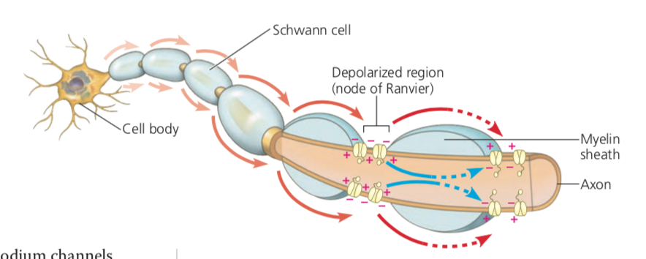
Saltatory Conduction
Nodes of Ranvier
Action potential travel along axon
“Leaps” from node to node
“Saltare” → to leap

Slide 16
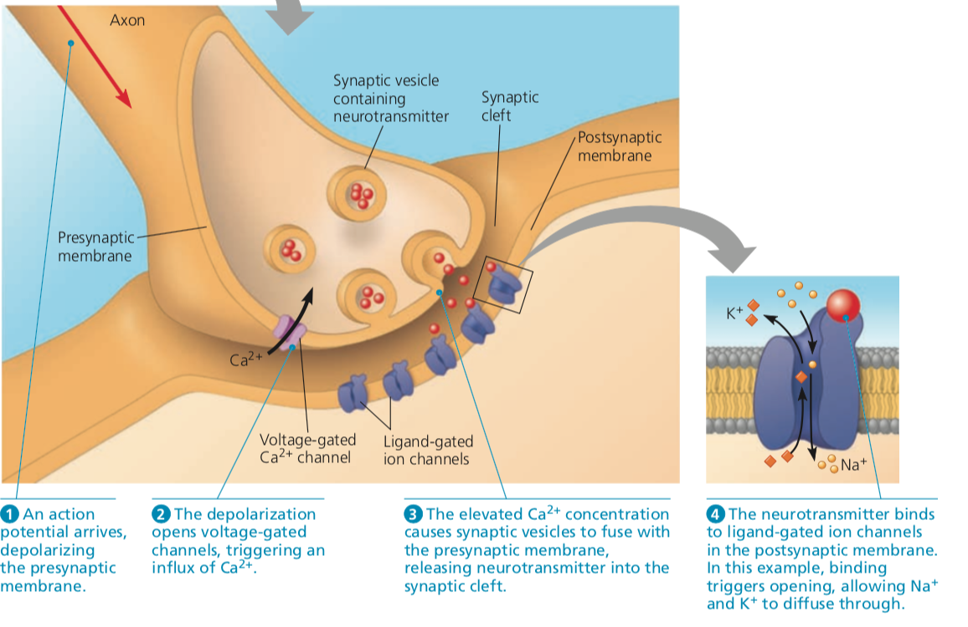
Communication through Neurotransmitters
SNARE protein

Slide 17
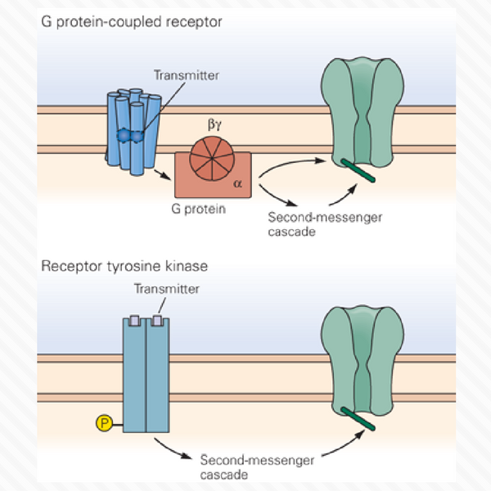
Receiving Signals
Types of receptors
Metatropic
Ionotropic
Response
Inhibitory postsynaptic potential
Excitatory postsynaptic potential

Slide 18
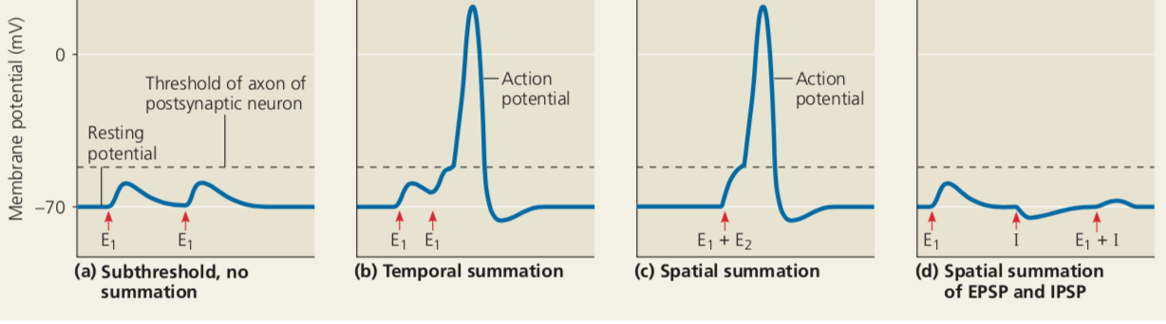
Summation of Postsynaptic Signals
EPSPs add together
Temporal summation
EPSPs excite different synapses
Spatial summation

Slide 19
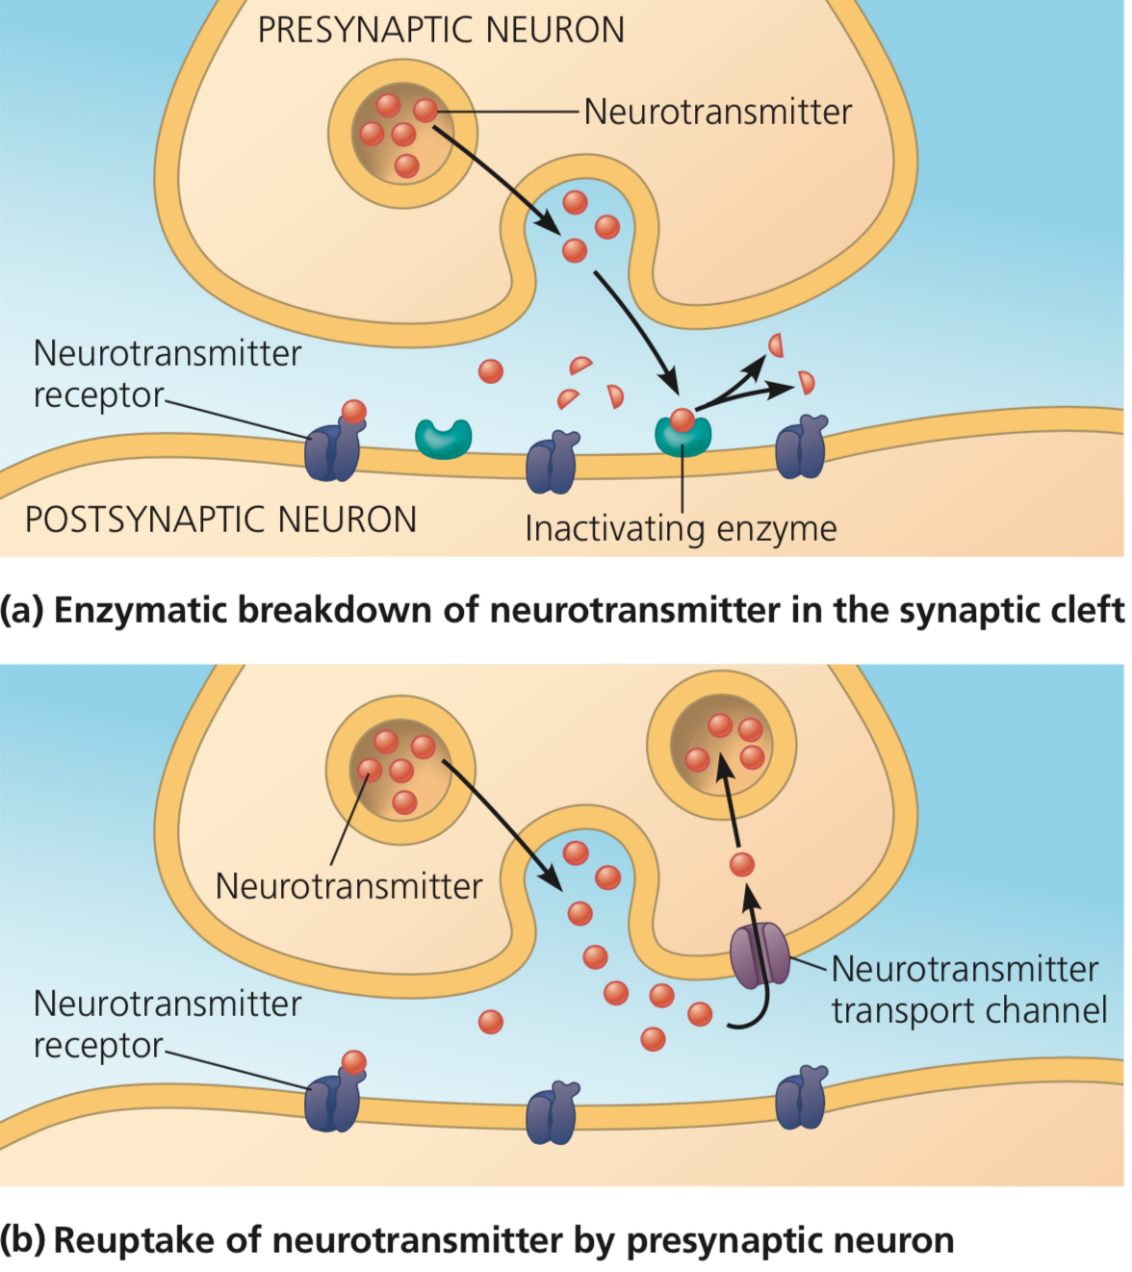
Neurotransmitters: Acetylcholine
Acetylcholine is excitatory
Not in heart

Slide 20
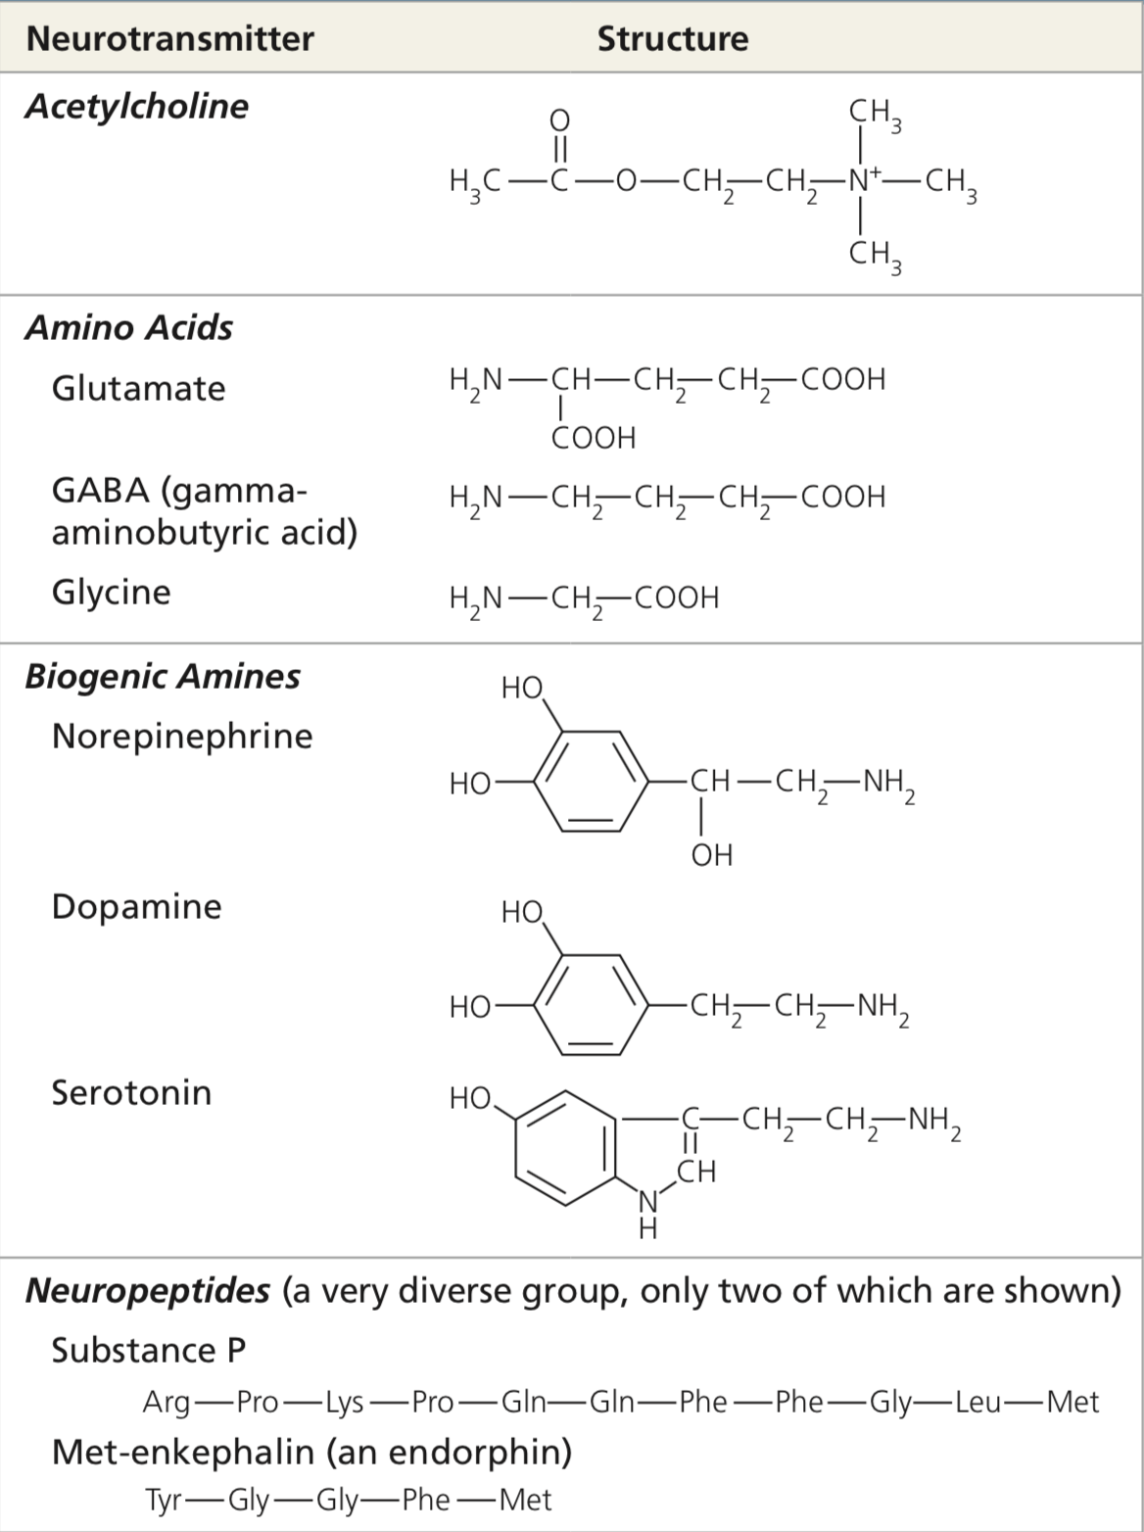
Types of Neurotransmitters

